Slide 1
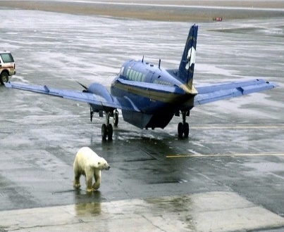
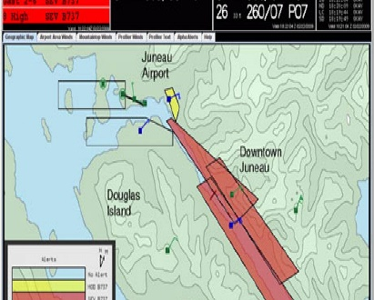
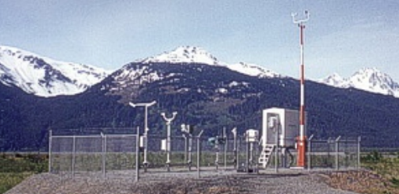
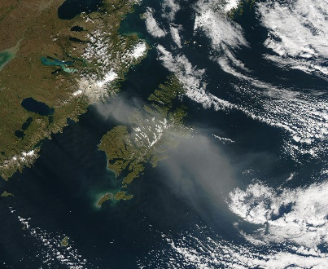
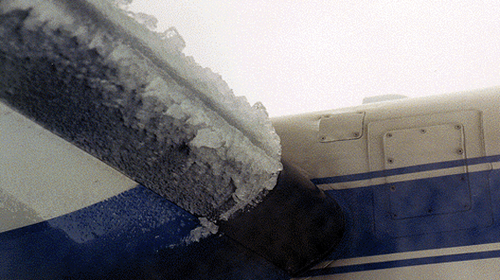
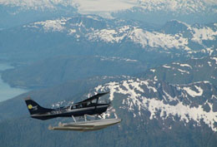
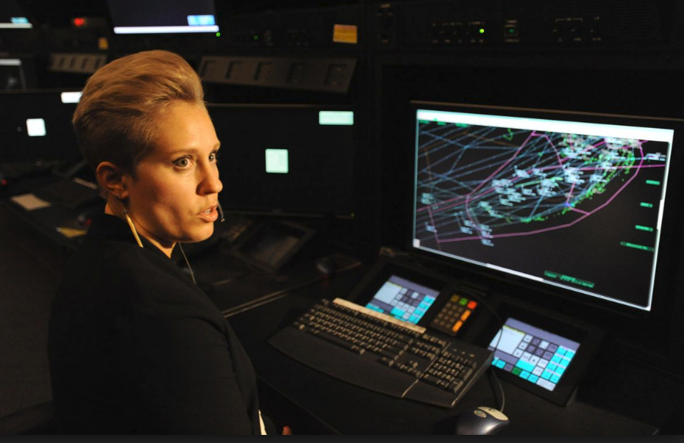
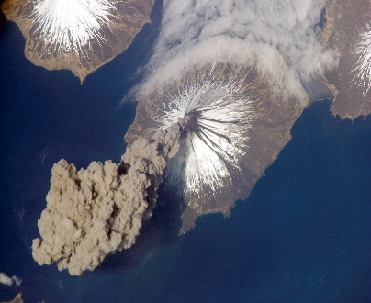
Alaska Aviation Weather Unit (AAWU) Volcanic Ash Advisory Center Anchorage
Jeff Osiensky Meteorologist In Charge

Slide 2
NWS Alaska Region Overview
Notes:
Hub of offices in Anchorage – here at Sand Lake – WFO, RFC, AAWU, Regional Facilities Palmer (one hour northeast) is the NTWC
Fairbanks and Juneau are the other 2 WFOs 11 WSOs

Slide 3
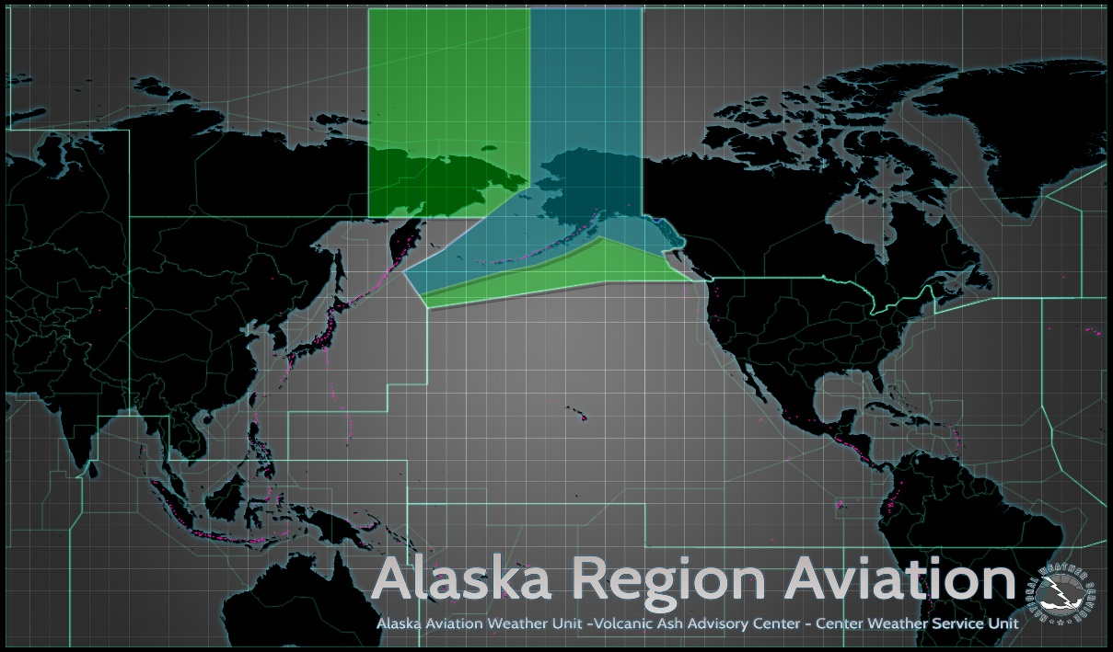
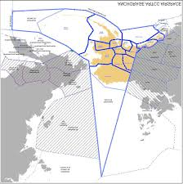
AAWU & VAAC
Two aviation forecasting functions rolled up into one office
Meteorological Watch Office (MWO) – one of three in the United States
State/Regional scope
Volcanic Ash Advisory Center (VAAC) – one of nine in the World
International scope

Slide 4
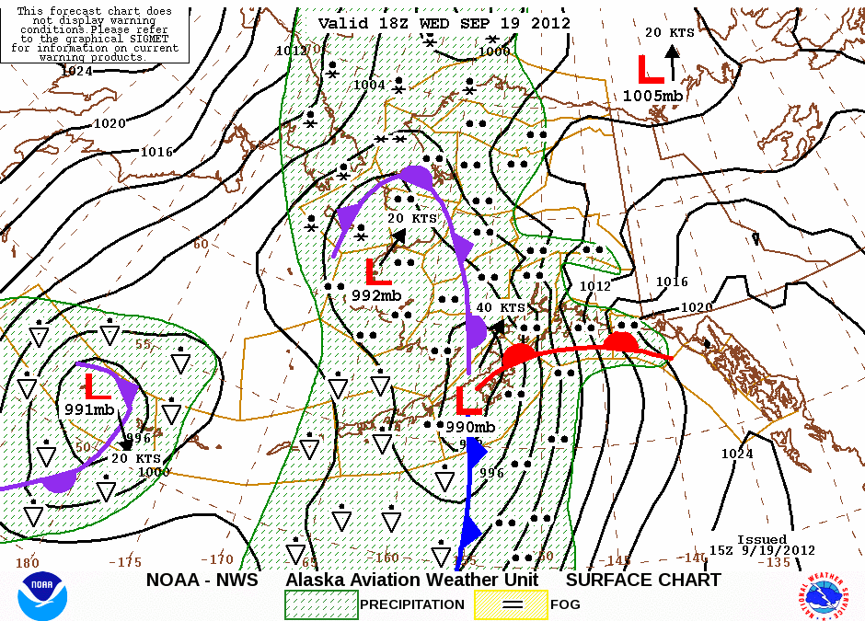
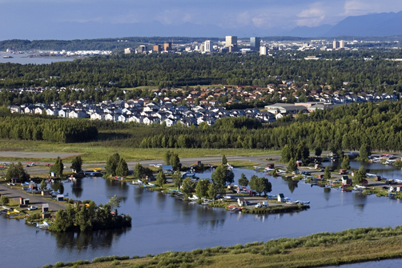
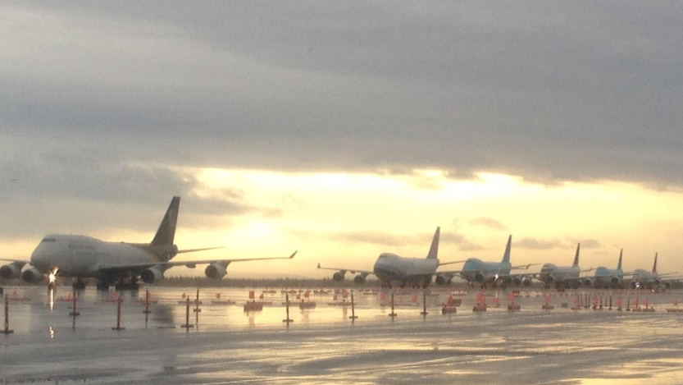
Alaska Aviation Weather Unit (Meteorological Watch Office)
Forecasts for AK’s 5.8 million sq. kilometer airspace with involvement from 5 offices (3 WFOs, CWSU, and AAWU)
Graphics, Area Forecasts, AIRMETs, and SIGMETs
Terminal forecasts for 39 airports issued by WFOs
Transmitted very 6 hours with routine updates for ANC at 7am & 21UTC (12pm AKST and 1pm AKDT)
Need for a strong internal collaborative forecast process
Close partnerships with FAA, industry, and formal Association to help guide services
Cargo Jets destined for Anchorage,
diverted to Fairbanks on Sept 19, 2012

Slide 5
Alaska Aviation Weather Unit (AAWU)

Slide 6
Operations

Slide 7
AAWU Staffing

Slide 8
AAWU Forecast Responsibility

Slide 9
Forecast Preparation
“GFE like”

Slide 10
Forecast Process

Slide 11
Forecast Process

Slide 12
Forecast Graphics

Slide 13
Area Forecast (FA)

Slide 14
AIRMET and SIGMET

Slide 15
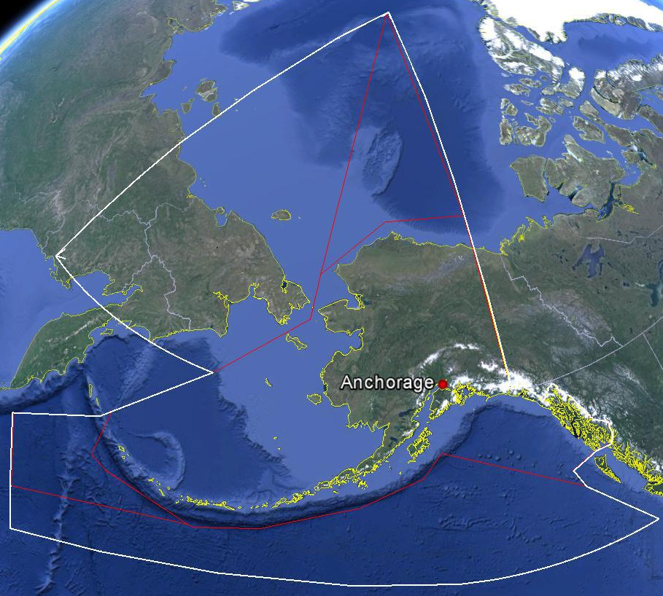
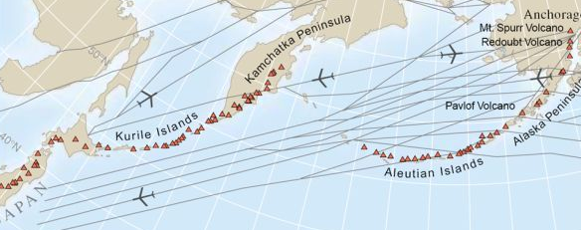
Volcanic Ash Advisory Center Anchorage
Backup Office
VAAC Anchorage of area of responsibility is approximately 12.1 square million kilometers
North Pacific air routes in close proximity to active volcanoes along with many Alaskan routes
Mt. Redoubt (April 21, 1990)

Slide 16
VAAC Anchorage

Slide 17
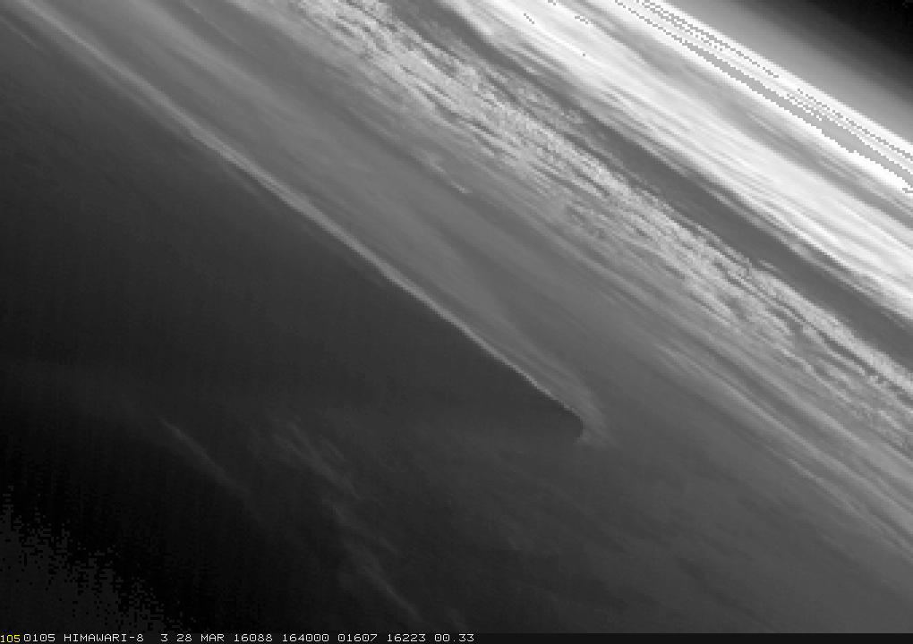
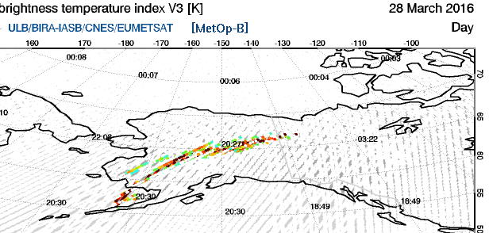
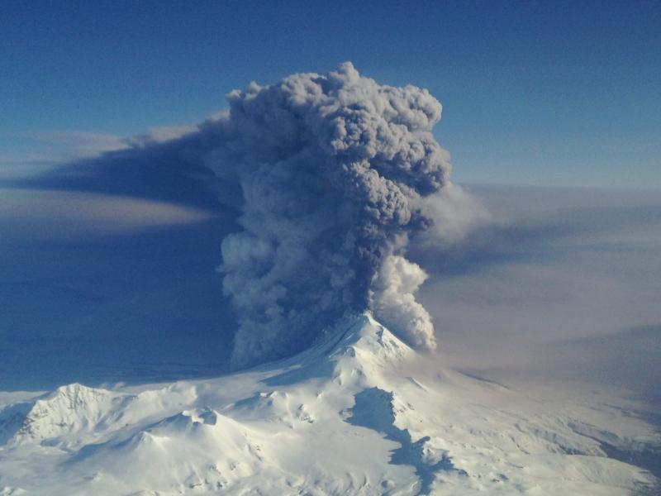
Pavlof Eruption 27-29 March 2016
1640-1850 UTC Himiwari-8
SO2 Brightness Temperature Index
28 March 2016 19-2030 UTC
Photo Credit U.S. Coast Guard at 20,000 feet
1914 UTC 28 March 2016
1357Z 28 Mar 2016
MODIS Derived Ash Cloud Top
Notes:
First indications of the eruption came from pilot reports, 0018 UTC 28 March 2016 (ash FL200 and below) with volcano in green status. Eruptions peaked 08-16 UTC 28 March with tops to FL400 and lightning, but nearly continuous eruptions persisted for around 36 hours. Fortunately, skies were generally not cloudy allowing for good viewing of the ash for a large portion of the event. Little directional wind shear existed which kept the ash confined to a more narrow plume, but the ash was transported a long distance (through AK and much of Canada) as it was caught up in strong winds.
Around 6200 passengers on Alaska Airlines alone dealt with flight cancellations in Alaska. Other smaller aviation groups were also significantly impacted with flight cancelations. High level flights deviated from their typical routes to avoid the ash. Fortunately the impacts were only felt for around 2 days in Alaska.
Himwari-8 (H-8) provided a reasonable good view of the eruption, despite Pavlof being on the limb of the imagery. Significant parallax issues existed with H-8, but the high temporal resolution provided excellent monitoring of the ongoing activity, which was especially helpful when the eruptions were more minor and not viewed in GOES (no brightness temperature difference). Recall GOES does not have all the channels necessary to identify volcanic ash clouds well. New RGB from POES imagery available in our operational system were also used for the first time while monitoring a volcanic eruption over Alaska. Automated alerts of satellite derived products (ash height) detected in satellite imagery were also utilized as has been the case for years. SO2 detection was used, especially near the end of the event, to determine where ash could be located since ash signatures on satellite were waning. No documented ash encounters or observations of sulfur smell

Slide 18
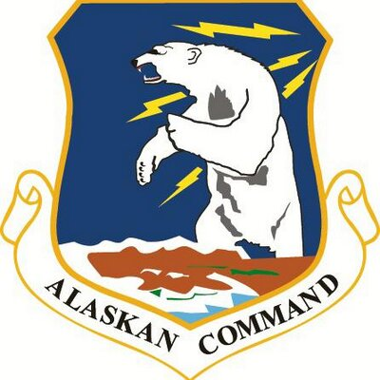
Deep Core Partnerships
Member: Alaska Aviation Coordination Council, Alaska Industry Council

Slide 19
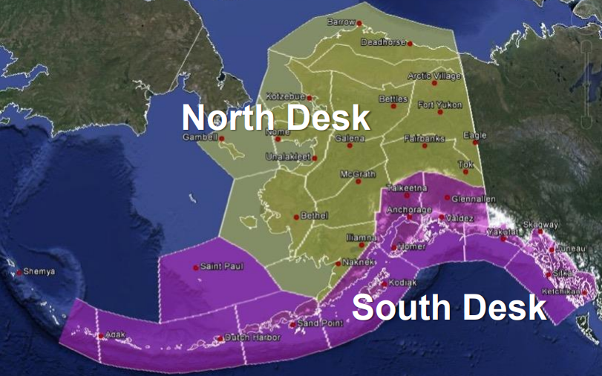
Contact Information
Jeff Osiensky, Meteorologist in Charge 907-266-5116 jeffrey.osiensky@noaa.gov
Doug Wesley, Science and Operations Officer 907-266-5112 douglas.wesley@noaa.gov
Operations 24x7x365
907-266-5109
907-266-5110

